Slide 1


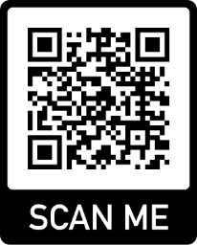
Assignments
Study and Exams
Essays, Reports and more
Reading and Writing
Collaborating and Presenting
Academic Integrity
Note-taking
Exam preparation
Assignment Planner (Time Management)
Academic Integrity
Expert Advice
Digital Skills
Expert advice
Free workshops and events (online and on campus)
Self-paced resources and guides
MESH
Maths & Stats
Study Smart Librarians
Research & Referencing
Studiosity
Writing feedback
Turnitin
EndNote
Generative AI
Digital learning
westernsydney.edu.au/studysmart
Notes:
General Study Smart Slide
QR Code goes to Study Smart Home Page

Slide 2

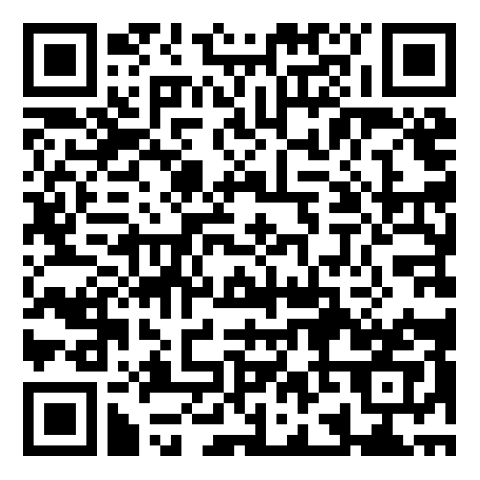
FREE WORKSHOPS IN SPRING
library.westernsydney.edu.au/about_us/whats_on
Get the edge for your assignments and exams!
How to write well at uni: common grammar errors
Notetaking: Making notes for now that make sense later
How to write in academic style
How to present confidently
I’ve marked 10,000 assignments – ask me anything!
Turnitin AI Detector: Information Session and Q&A
and more
Scan to register
online or on campus
Notes:
Study Smart Events Slide
QR code goes to Study Smart Events page

Slide 3
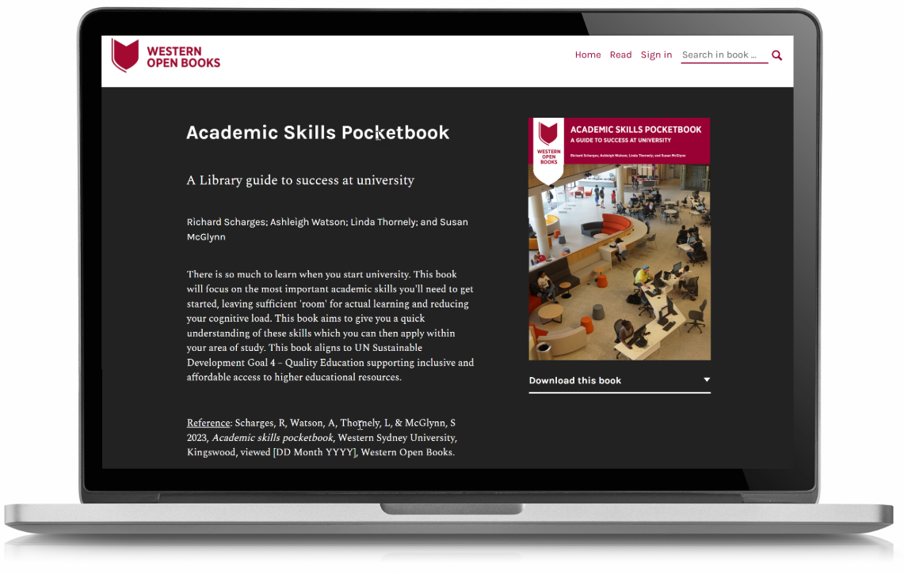
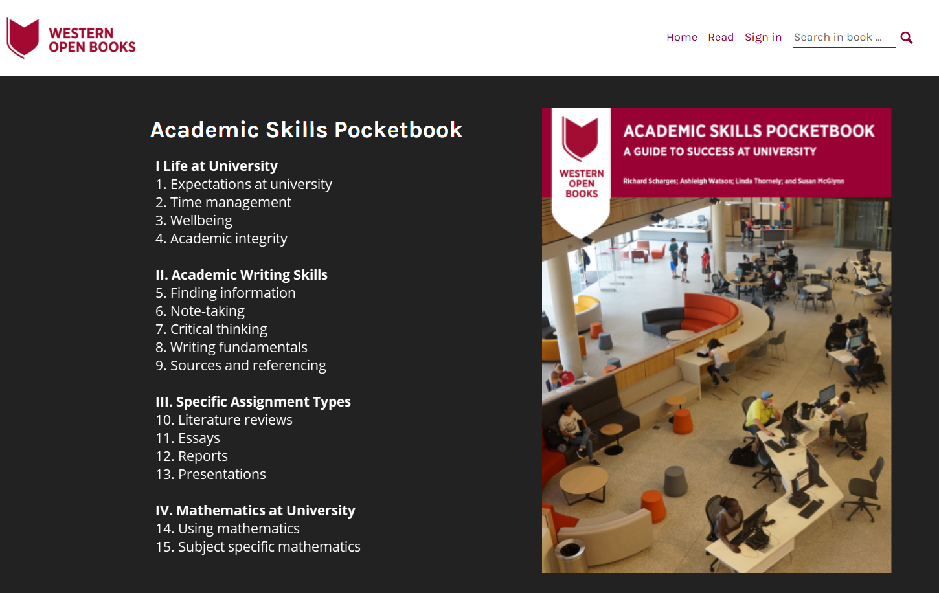
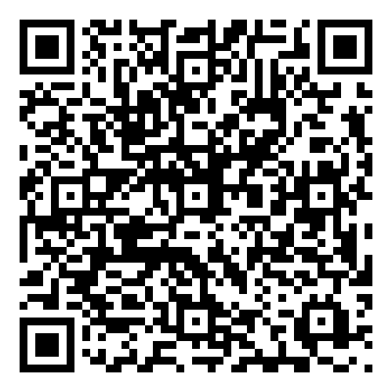
ACADEMIC SKILLS POCKETBOOK
westernsydney.pressbooks.pub/aspocketbook
New to uni?
Not sure where to start?
Grab your FREE guide to
academic success
Tips, tricks, and support to help you thrive at Western from day one.
Notes:
Academic Skills Pocketbook
QR code goes to

Slide 4

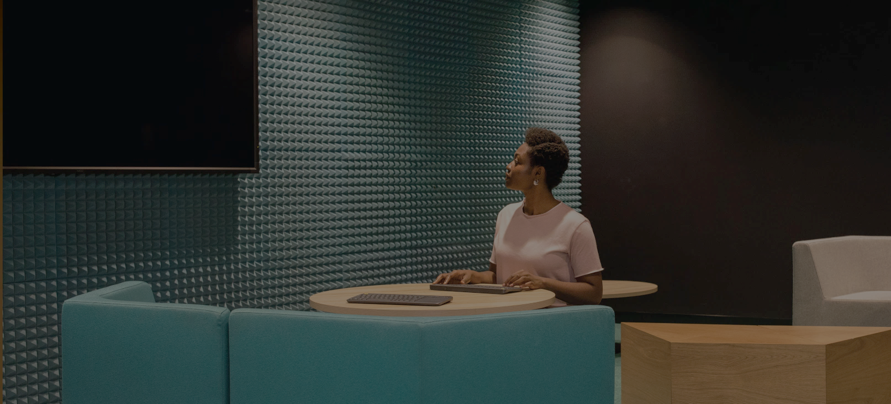
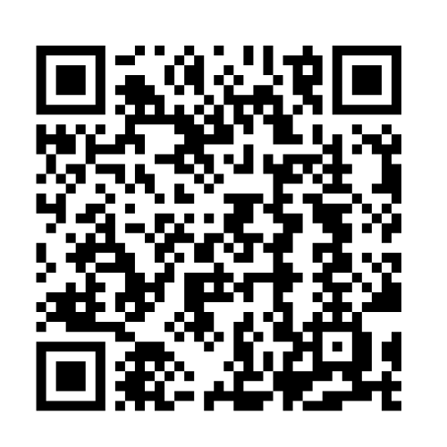
EXPERT ADVICE
westernsydney.edu.au/studysmart/home/study_smart_appointments
MESH – maths and stats
Subject specific resources and events
Drop-in zoom or on campus sessions
Librarians – searching and referencing
Boost your searching and referencing skills
20 min zoom or on campus appointments
Studiosity - writing feedback
Upload a draft or use the 24/7 live chat
Access within vUWS. Limits apply
Notes:
Expert Advice Slide
FREE FOR WSU STUDENTS
QR codes go to Study Smart Appointments page

Slide 5
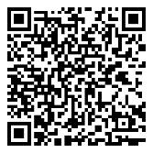
LIBRARIANS
westernsydney.edu.au/studysmart/home/study_smart_appointments
Free 20-minute one-to-one appointment tailored to you!
Searching for quality scholarly resources
Using library databases
Advanced searching techniques
Referencing and referencing tools (EndNote)
Connecting you with resources to develop your academic writing
Organisational skills to reduce study stress.
Book an appointment online or on campus
Notes:
Study Smart Librarian Slide
QR Code goes to Study Smart Librarian

Slide 6


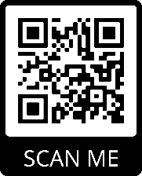
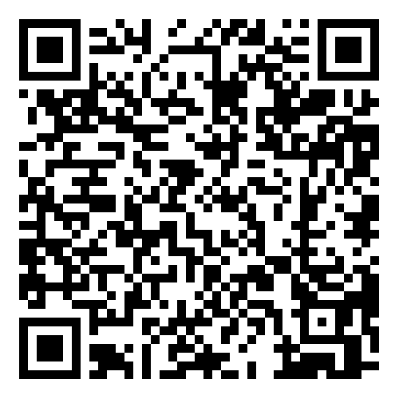
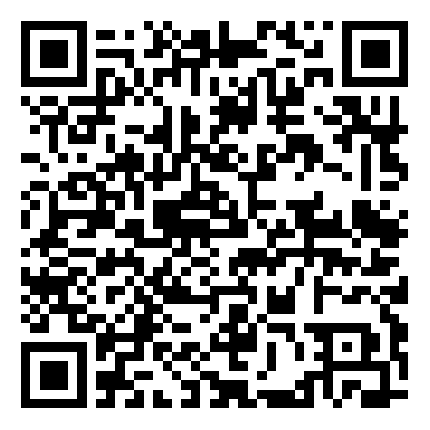
SEARCHING AND REFERENCING
westernsydney.edu.au/studysmart/home/information_skills
SEARCHING
How-to guides and tutorials
Searching workshops
Study Smart Librarian – Free on campus and zoom appointments
REFERENCING
Style guides, YouTube videos & FAQs
Paraphrasing & Turnitin workshops
EndNote (reference management)
Study Smart Librarian – Free on campus and zoom appointments
Notes:
Searching and Referencing Support Slide
QR codes go to
Study Smart Information Skills page
Library Referencing and Citation page

Slide 7

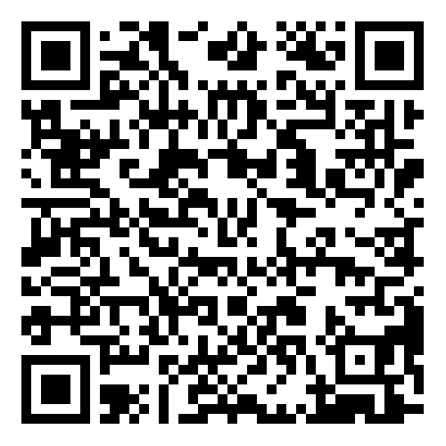
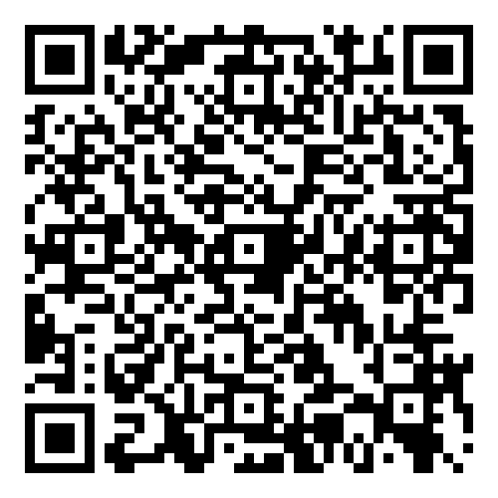
REPORTS AND PRESENTATIONS
westernsydney.edu.au/studysmart/home/reading_and_writing
westernsydney.edu.au/studysmart/home/speaking_collaborating_and_presenting
REPORTS
How-to guides
Report and general writing workshops
Assignment Planner tool
Studiosity in vUWS – writing feedback
PRESENTATIONS
How-to guides
Presentation checklist
Presentation workshops
Studiosity in vUWS – writing feedback for slides
Notes:
Reports and Presentations Slide
QR codes go to
Study Smart – Reading and Writing page
Study Smart – Speaking Collaborating and Presenting page

Slide 8

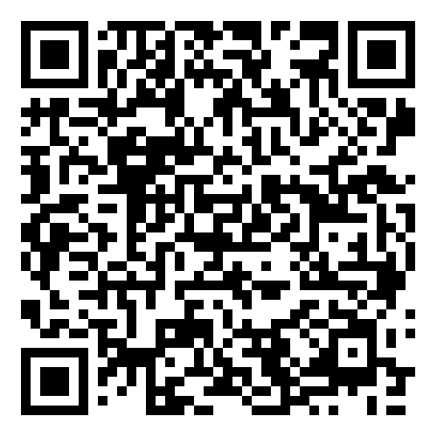
STUDY AND EXAMS
westernsydney.edu.au/studysmart/home/study_and_exam_success
STUDY TECHNIQUES
PASS, MATES, Tutoring for Success
How-to-guides
Note-taking, reading and study techniques workshops
Assignment Planner tool
EXAMS
PASS, MATES, Tutoring for Success
How-to-guides
Exam preparation and revising workshops
Notes:
Study and Exams Support Slide
QR codes go to Study Smart Study and Exam Success page

